Slide 1
India EV market
( 2001- 2024 )
By : Athul Das P
08/10/25

Slide 2
Business context
India’s electric vehicle (EV) market is undergoing rapid growth driven by rising fuel costs, government incentives (FAME-II, State EV subsidies), expanding charging infrastructure, and increasing consumer adoption of two-wheelers and three-wheelers.
EV manufacturers, policymakers, logistics companies, and investors are aggressively trying to understand:
Which segments (2W/3W/4W) are driving the EV boom
Which states and cities are leading adoption
Which OEMs (Ola Electric, Ather, Tata Motors, TVS, etc.) are dominating and how their shares change over time
How policy changes and new launches influence demand
How operational vehicles vs. registered vehicles differ
Category-wise market penetration: BEV, PHEV, HEV, E-rickshaw, cargo three-wheelers, etc.
Companies in the EV ecosystem—manufacturers, dealerships, chargers, fleet operators, last-mile logistics startups, and investors—depend on this type of analysis to make strategic decisions on product development, pricing, capacity expansion, and city-level rollout.

Slide 3
Data dictionary
Table name | Column names | Description
Fact category | FactCategoryID | Unique id.Ensures uniqueness of each row.
 | Date | Full calendar date of registration record.
 | Year | Extracted year from the date column.
 | Rawcategory | Original vehicle class name as found in the input dataset.
 | Registrations | Number of vehicles registered for this category on this specific date.
 | Category group | Standardized grouping for analysis (2W, 3W, 4W, Commercial, Other).

Slide 4
Table name | Column names | Description
Fact maker sales | Maker salesID | Unique id for the fact table. Ensures each row is unique.
 | Maker | Name of the EV manufacturer.
 | Raw category | Original category label from the source dataset (2W, 3W, LMV, HMV, etc.).
 | Year | Year for which the sales value is reported.
 | Sales | Number of vehicles sold by the maker in that category for that year.
 | Category group | Cleaned, standardized category used for analysis (2W, 3W, 4W, Commercial, Other).

Slide 5
Table name | Column names | Description
Category map | Raw category | The original category label exactly as it appears in the source data.
 | Category map | Standardized grouping assigned to each raw category.

Slide 6
Table name | Column names | Description
Dim maker location | Maker | Name of the EV manufacturer.
 | Place | City or specific location where the maker has an operational unit or office.
 | State | Indian state corresponding to the place.

Slide 7
Table name | Column names | Description
Dim state | State ID | primary key for the dimension table.
 | State | Name of the state.
 | Maker count | Number of distinct EV makers present in the state.
 | Makers list | Comma-separated list of EV makers operating in the state.
 | No of operational PCS | Total number of public charging stations in the state.

Slide 8
Table name | Column names | Description
Maker state presence | Maker | Name of the EV manufacturer (canonicalized).
 | State | State in which the maker has presence (normalized).

Slide 9
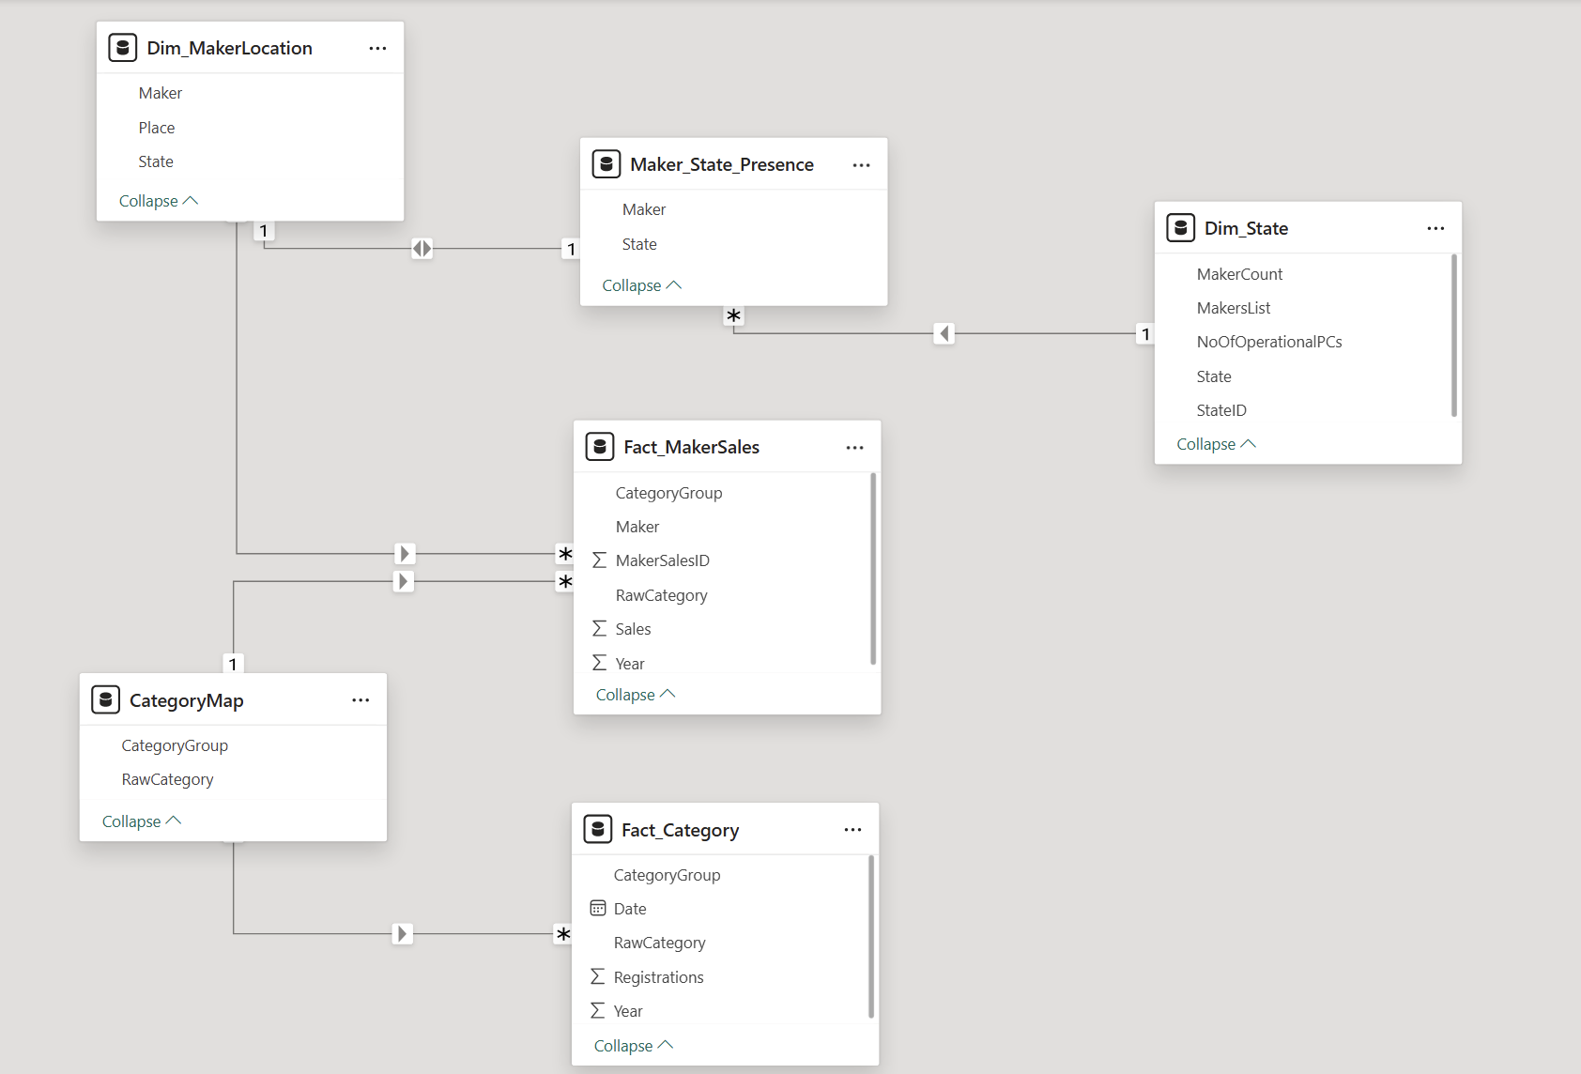
Table Relationship

Slide 10
Data checks
Fact category
Table inspection
No of records : 4528
Columns : Date, Year, Raw Category, Registrations, Category group.
Data quality checks
No duplicate records
No missing values
No date format issue
Insights
Date ranges from 2001 to 2024.
There are 16 raw categories.
There are 5 category groups.

Slide 11
Fact maker sales
Table inspection
No of records : 13860
Columns : maker sales id, maker, raw category, year, sales, category group
Data quality checks
No duplicate records
No missing values
No date format issue
Insights
The Fact Maker Sales table is sourced from the EV sales by maker (2015–2024) dataset, which reports sales only at a high-level segment, unlike the detailed government registration dataset. So the table only contains 4 raw categories. 2w,3w,lmv,mmv.
Year ranges from 2015 to 2024.

Slide 12
Category map
Table inspection
No of records : 20
Columns : Raw category, category group.
Data quality checks
No duplicate records
No missing values
Insights
There are 20 categories.
5 category groups.

Slide 13
Dim maker location
Table inspection
No of records : 61
Columns :Maker, place, state.
Data quality checks
No duplicate records
No missing values
Insights
There are 61 makers.

Slide 14
Dim state
Table inspection
No of records : 13
Columns : State id, state, maker count, makers list, no of operational PCs.
Data quality checks
No duplicate records
No missing values
Insights
There are average 746 operational PCs per state.

Slide 15
Maker state presence
Table inspection
No of records : 61
Columns : State id, state, maker count, makers list, no of operational PCs.
Data quality checks
No duplicate records
No missing values
Insights
Dim Maker Location defines where each EV manufacturer is physically located, while Maker State Presence defines the states where the manufacturer operates.

Slide 16
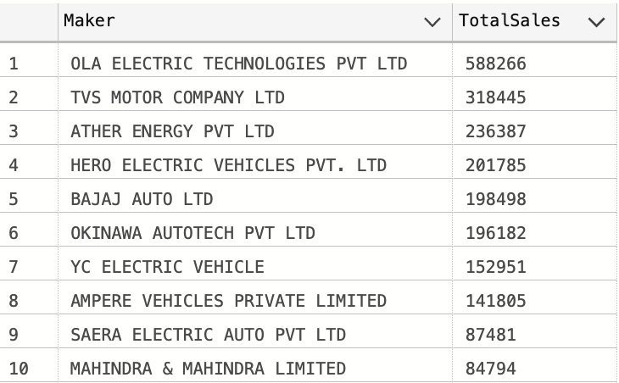
Detailed EDA
Total sales all years
Total number ev’s sold is 44,20,903
Top 10 makers by cumulative sales

Slide 17
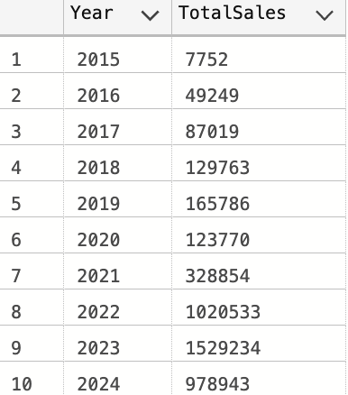
Sales by raw category
Category two wheeler has sold the most (22,79,448).
Mmv has sold the least (884).
* mmv means mid weight commercial vehicles such as medium trucks and transport carriers.
Yearly total sales

Slide 18
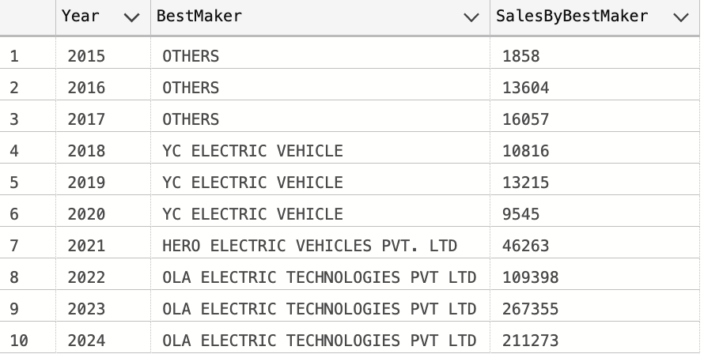
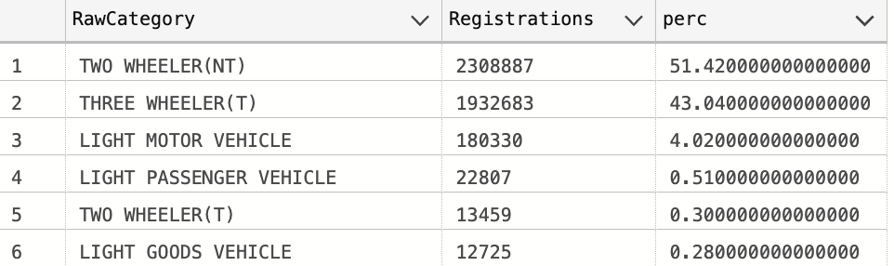
Best maker per year
Ola has been the best selling ev brand since 2022.
Registrations by raw category
51% of the registered ev vehicles belong to the raw category two wheeler (NT).
43% belongs to the raw category three wheeler (T).

Slide 19
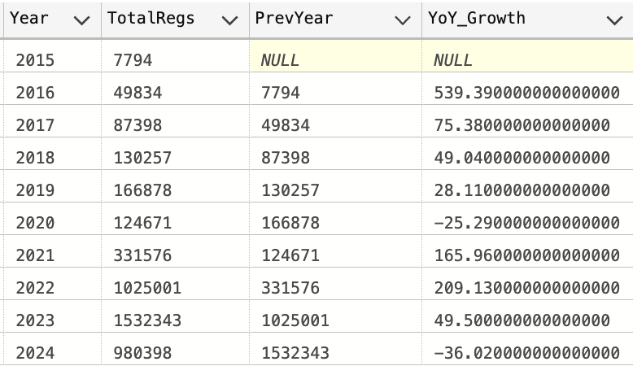
Makers per state
State of Maharashtra has the highest number of ev makers.
Then comes tamilnadu.
Pune (7), Bengaluru (6), Chennai (5) are the cities with highest no of ev makers.
Year over year growth %
Ev adoption accelerated sharply post 2021.
The highest YoY growth was observed in 2022.

Slide 20
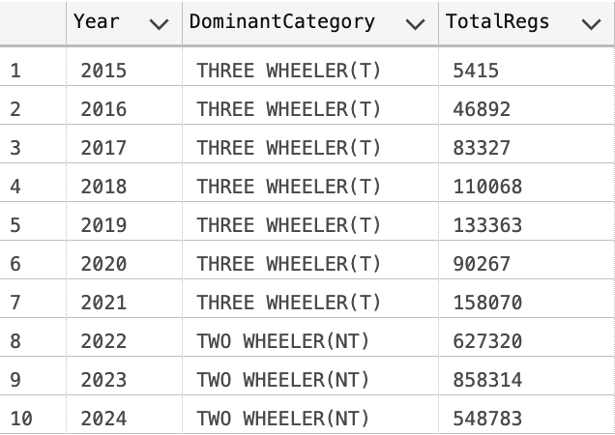
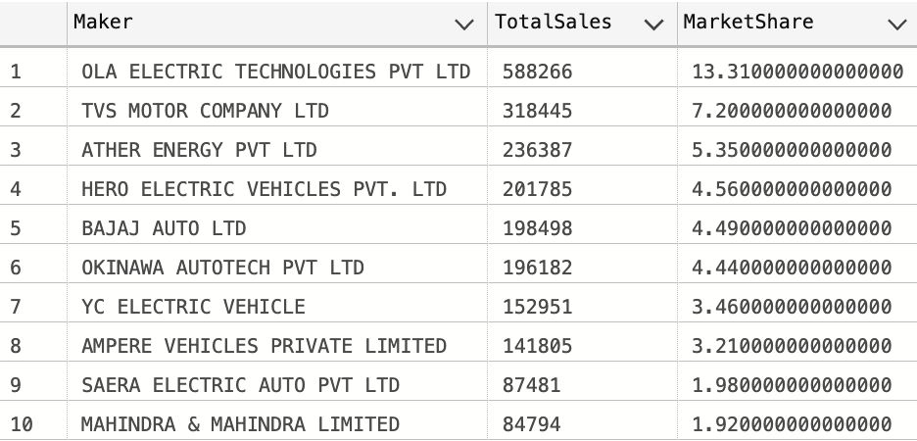
Dominant raw category per year
Early years show dominance of e-rickshaws.
2W ev adoption exploded after 2020.
Heavy /light passenger vehicles remain niche.
Sales concentration ratio
A few makers dominate the ev market share.
OLA has the highest market share.

Slide 21
Detailed List of Exploratory Data Analysis
KPI’s (what we measure)
Market kpi’s :
Total ev registrations
YoY ev growth rate
Category group market share
2W penetration rate
Peak ev registration year
Maker kpi’s :
Top manufacturer (current year)
Maker market share
Best selling category for maker
Total makers active in market
New makers added this year
Geographic kpi’s :
Top state by maker presence
Cities with highest ev sales.

Slide 22
Kra’s (key result areas)
Market performance kra’s :
Overall ev market growth
Adoption of major ev categories
Transition from traditional categories
Manufacturer performance kra’s :
Maker sales performance by year
Maker category specialization
Maker competitive position
Geographic kra’s :
Expansion of ev manufacturing hubs.
Geographic distribution of production capacity.

Slide 23
Kri’s (key risk indiacators)
Market risk kri’s :
Heavy dependence on 2W segment.
Limited adoption of lmv mmv categories.
Market concentration risk.
Analytical risks :
Missing state level sales data (only HQ data available.
Over representation of certain makers or years.
Descriptive analyses (what is happening)
Market descriptive analyses :
Yearly total ev registrations
Category distribution
Sales contribution by raw category
Maker count and distribution
Category group composition over time

Slide 24
Maker descriptive analyses :
Total sales per maker
Best maker per year
Maker category mix
Maker entry year
Maker geographic presence
Geographic descriptive analyses :
States with highest number of manufacturers
City level clusters
Regional concentration
Diagnostic analyses (why is it happening)
Market diagnostic analyses :
Why 2W dominates the market(affordability ,urban use)
Why 3W evs grew early (e-rickshaw demand in tier 2 cities)
Why growth surged after 2021

Slide 25
Maker diagnostic analyses :
Why certain makers lead in specific years
Why new entrants spike post 2020
Why lmv mmv sales remain low
Geographic diagnostic analyses
Why states like Tamil Nadu, Karnataka lead manufacturing
Why tier 1 cities host more ev startups

Slide 26
EV market360 dashboard layout
Objective
Understand the overall ev market trend in India, category performance, yearly growth and how different categories contribute to the industry.
logo
Title
KPI’s=Total ev registrations, YoY growth %, top category (by volume), market share of 2W(%), total active manufacturers
Slicers :
Year, category group, raw category, maker, state(HQ)
Charts ;
Yearly ev registration trend – line chart
Category contribution – stacked bar chart
Category growth YoY – area chart
Best maker per year – column chart
Maker sales distribution – bar chart
Ev manufacturing density map – heat map

Slide 27
Manufacturer (Maker)360 dashboard layout
Objective
Understand manufacturer performance, category specialization, market leadership and geographic presence.
logo
Title
KPI’s=Total makers, top maker of the year, new makers of this year, top category for maker, maker market share
Slicers :
Year, category group, raw category, maker, state(HQ)
Charts ;
Maker performance over time – line chart
Maker category mix – donut chart
Market share comparison – bar chart
Maker entry timeline – bar chart
state presence heatmap - table

Slide 28
THANK YOU!

